Slide 1
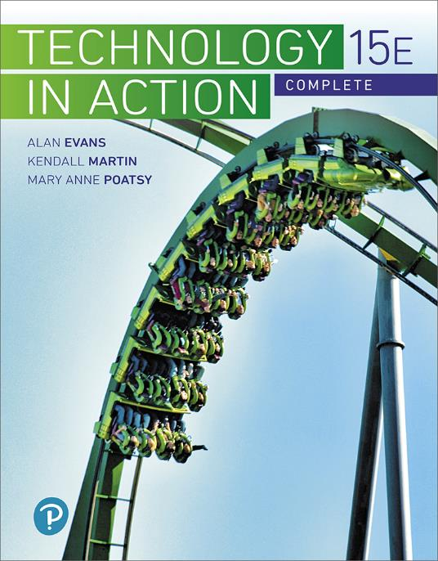
Technology in Action
15th Edition
Appendix A
The History of the Personal Computer
Notes:
If this PowerPoint presentation contains mathematical equations, you may need to check that your computer has the following installed:
1) MathType Plugin
2) Math Player (free versions available)
3) NVDA Reader (free versions available)

Slide 2
Learning Objectives (1 of 3)
A.1 Describe the earliest personal computer ever designed.
A.2 Describe the distinguishing features of the Apple I and Apple II.
A.3 Describe the first portable computer.
A.4 Describe the development of the IBM PC.
A.5 Explain why BASIC was an important step in revolutionizing the software industry.
A.6 Explain why the development of the operating system was an important step in PC development.
Notes:
Slide 2 is a partial list of textbook Learning Objectives numbers and statements.

Slide 3
Learning Objectives (2 of 3)
A.7 List early application software that was developed for the PC.
A.8 Describe the features of the Lisa and Macintosh computers and their predecessor, the Xerox Alto.
A.9 List the first successful web browsers.
A.10 Discuss the features of the Pascalene calculator and the Jacquard loom that inspired modern computer elements.
Notes:
Slide 3 is a continuation of textbook Learning Objectives numbers and statements.

Slide 4
Learning Objectives (3 of 3)
A.11 Discuss the contributions of Babbage’s engines and the Hollerith Tabulating Machine to modern computing.
A.12 Discuss the features of the Z1, the Atansoff–Berry Computer, and the Mark I.
A.13 Discuss the major features of the Turing Machine, the ENIAC, and the UNIVAC.
A.14 Describe the milestones that led to each “generation” of computers.
Notes:
Slide 4 is the final list of textbook Learning Objectives numbers and statements.

Slide 5
Early Personal Computers The First Personal Computer: The Altair (Objective A.1)
1975
Sold as a kit
No keyboard: Used switches for input
No monitor: Used lights for output
Bill Gates and Paul Allen among first owners
Wrote compiling program
Notes:
The Altair 8800 debuted in 1975, touted as the first personal computer.
It appeared on the cover of Popular Electronics in 1975, and quickly there were hundreds of orders a month for the $395 box of parts.
Switches were used for input and lights for output, and the machine had a total of 256 bytes of memory. (Today’s computers have 256,000,000 bytes!)
Bill Gates and Paul Allen saw the cover article, left Harvard, and flew to Albuquerque, New Mexico, convincing Altair’s developer that they could write a compiler to run the BASIC computer language on the Altair. Their success led to the formation of Microsoft.

Slide 6
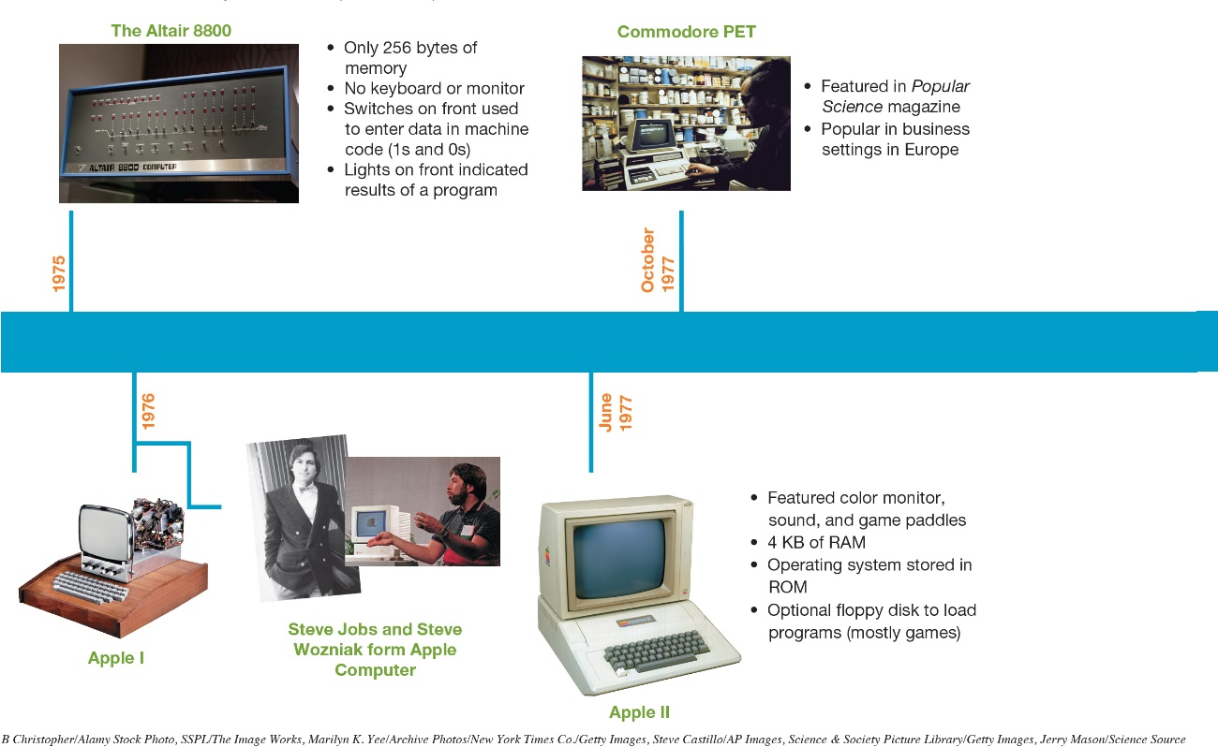
Early Personal Computers The Apple I and II (Objective A.2)
Built by Steve Jobs and Steve Wozniak
Operating system stored in ROM
Notes:
Steve Wozniak and Steve Jobs built a personal computer, the Apple I, in Wozniak’s garage and formed the Apple Computer Company in 1976.
A year later, in 1977, the Apple II was born.
One of its biggest innovations was that the operating system was stored in read-only memory (ROM). Previously, the operating system had to be rewritten every time the computer was turned on.

Slide 7
Enter the Competition The Osborne: The Birth of Portable Computing (Objective A.3)
Introduced in 1981
Cost $1,795
Weighed 24.5 pounds
5 inch screen
Overnight success
Sold to Compaq in 1983
Notes:
The Osborne Company introduced the industry’s first portable computer, the Osborne, in April 1981; it weighed 24.5 pounds. Its screen was just 5 inches wide. The Osborne cost $1,795. It was an overnight success. They sold to Compaq in 1983.

Slide 8
Enter the Competition IBM PCs (Objective A.4)
Prior to 1980: Known for mainframes
1981: Entered small-computer market with IBM PC
Started at $1,565
Sold at retail outlets (Sears)
1982: Named “Machine of the Year”
Notes:
By 1980, IBM recognized it needed to get into the personal computer market.
In August 1981, IBM released its first personal computer named the IBM PC. The term PC soon became the term used to describe all personal computers.
It was sold through retail outlets such as Sears to reach the home market and it quickly dominated the playing field.
In January 1983, Time magazine named the IBM PC “1982 machine of the year.”

Slide 9
Other Important Advancements The Importance of BASIC (1 of 2) (Objective A.5)
Programming languages in the 1950s
FORTRAN, ALGOL, and COBOL
Used mainly by businesses
Used to create financial, statistical, and engineering programs
Notes:
The software industry began in the 1950s with the development of programming languages such as FORTRAN, ALGOL, and COBOL. These languages were used mainly by businesses to create financial, statistical, and engineering programs for corporate enterprises.

Slide 10
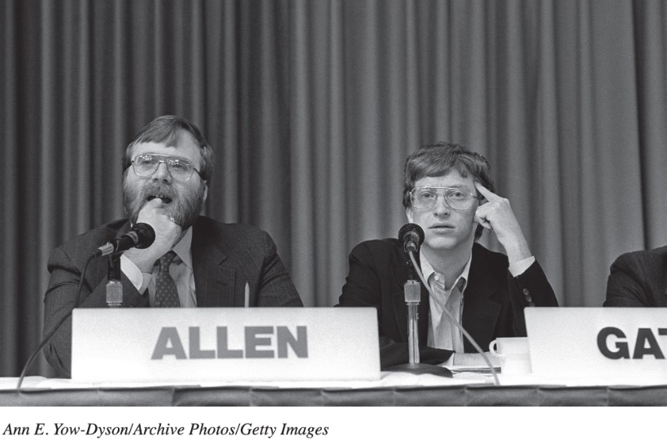
Other Important Advancements The Importance of BASIC (2 of 2) (Objective A.5)
Beginners All-Purpose Symbolic Instruction Code (BASIC)
Introduced in 1964
Revolutionized software industry
Easily learned by beginning programmers
Became key language for PC
Led to creation of Microsoft
Notes:
The 1964 introduction of Beginners All-Purpose Symbolic Instruction Code (BASIC) revolutionized the software industry. BASIC was a programming language that the beginning programming student could easily learn. It thus became enormously popular, and the key language of the PC. In fact, Bill Gates and Paul Allen used BASIC to write their program for the Altair. As we noted earlier, this program led to the creation of Microsoft, a company that produced software for the microcomputer.

Slide 11
Other Important Advancements The Advent of Operating Systems (1 of 2) (Objective A.6)
Early programs and data saved on audiocassettes
Programs needed to be rewritten each time
Floppy disk drive was introduced in 1978
Programs could be saved so operating systems were developed
Notes:
Because data on the earliest PCs was stored on audiocassettes (not floppy disks).
Many programs were not saved or reused.
With the floppy drive, introduced in 1978, programs could be saved with more efficiency, and operating systems (OSs) were developed.

Slide 12
Other Important Advancements The Advent of Operating Systems (2 of 2) (Objective A.6)
Operating systems coordinate with specific processor chip
Apple computers – Motorola chips: Disk Operating System (DOS) OS (1977)
PCs – Intel 8080 chips: Control Program for Microcomputers (CP/M) OS
Microsoft – Intel chips: MS-DOS (1980)
Operating system for IBM PCs
Created by Bill Gates
Notes:
Disk Operating System (DOS), developed by Wozniak and introduced in December 1977, was the OS that controlled the first Apple computers.
The Control Program for Microcomputers (CP/M), developed by Gary Kildall, was the first OS designed for the Intel 8080 chip (the processor for PCs).
In 1980, when IBM approached Bill Gates at Microsoft to write an OS program for the IBM PC, Gates wrote an OS program and developed MS-DOS for IBM computers.

Slide 13
Other Important Advancements Software Application Explosion: VisiCalc and Beyond (Objective A.7)
Spreadsheets
VisiCalc
Lotus 1-2-3
Microsoft Excel
Word Processing
WordStar
Word for MS-DOS
WordPerfect
Notes:
Inclusion of floppy disk drives in personal computers not only facilitated the storage of operating systems, but also set off a software application explosion.
In 1978, Dan Bricklin recognized the potential for a spreadsheet program that could be used on PCs. He and his friend Bob Frankston created the program VisiCalc. VisiCalc became an instant success, with more than 100,000 copies sold in its first year.
After VisiCalc, other electronic spreadsheet programs entered the market: Lotus 1-2-3 in 1983 and Microsoft Excel in 1985.
Meanwhile, word processing software was gaining a foothold. WordStar, the first word processing application, came out in disk form in 1979. Competitors such as Word for MS-DOS (the precursor to Microsoft Word) and WordPerfect soon entered the market.

Slide 14
The Graphical User Interface and the Internet Boom Xerox and Apple’s Lisa and Macintosh (1 of 3) (Objective A.8)
Graphical User Interface (GUI) allowed users to interact with computer more easily
Previously used command or menu driven interfaces
GUI not invented by a computer company
Notes:
Another important advancement in PCs was the introduction of the graphical user interface (GUI), which allowed users to interact with the computer more easily.

Slide 15
The Graphical User Interface and the Internet Boom Xerox and Apple’s Lisa and Macintosh (2 of 3) (Objective A.8)
Xerox Alto (1972)
Introduced “What You See Is What You Get” (WYSIWYG)
File Management system with directories and folders
Mouse and network connectivity
Never sold commercially
Notes:
In 1972, Xerox was hard at work in its Palo Alto Research Center designing a PC of its own. Named the Alto, it included a mouse and a file management system with directories and folders. The computer included a word processor, based on the What You See Is What You Get (WYSIWYG) principle, that incorporated a file management system with directories and folders. For a variety of reasons, Xerox never sold the Alto commercially.

Slide 16
The Graphical User Interface and the Internet Boom Xerox and Apple’s Lisa and Macintosh (3 of 3) (Objective A.8)
Apple Lisa (1983)
First successful PC using GUI
Windows, drop-down menus, icons, a file system with folders and files
Very expensive
Apple Macintosh (1984)
1/3 cost of Lisa
Introduced 3.5-inch floppy disk
Notes:
In 1983, Apple introduced the Lisa, the first successful PC brought to market to use a GUI. It incorporated a user interface similar to the Alto, including features such as windows, drop-down menus, icons, a file system with folders and files, and a mouse.
In 1984, Apple introduced the Macintosh, which was everything the Lisa was and then some, at about a third of the cost. The Macintosh was also the first personal computer to introduce 3.5-inch floppy disks with a hard cover.

Slide 17
The Graphical User Interface and the Internet Boom The Internet Boom (Objective A.9)
1993: Mosaic browser introduced
1994: Netscape launched
1995: Internet Explorer introduced by Microsoft
1998: Netscape became open source
Notes:
The GUI made it easier for users to work on the computer. The Internet provided another reason for consumers to buy computers. Now they could conduct research and communicate with each other in a new and convenient way.
In 1993, the Web browser Mosaic was introduced. This browser allowed users to view multimedia on the web, causing Internet traffic to increase by nearly 350 percent.
In 1994, the Mosaic development team developed the commercial Web browser Netscape. Netscape’s popularity grew quickly, and it soon became a predominant player in browser software.
Meanwhile, companies discovered the Internet as a means to do business, and computer sales took off. IBM-compatible PCs became the PC system of choice when, in 1995, Microsoft introduced Internet Explorer, a Web browser that integrated Web functionality into Microsoft Office applications, and Windows 95, the first Microsoft OS designed to be principally a GUI OS.
In 1998, Netscape announced it was moving to the open source market and would no longer charge for the product, making the code available to the public.

Slide 18
Making the Personal Computer Possible: Early Computers The Pascalene Calculator and the Jacquard Loom (1 of 2) (Objective A.10)
First accurate mechanical calculator
Created by Blaise Pascal in 1642
Used revolutions of gears to count by tens
Could be used to add, subtract, multiply, and divide
Basic design used in mechanical calculators for 300 years
Notes:
The Pascalene was the first accurate mechanical calculator. This machine, created by French mathematician Blaise Pascal in 1642, used revolutions of gears, like odometers in cars do, to count by tens. The Pascalene could be used to add, subtract, multiply, and divide. The basic design of the Pascalene was so sound that it lived on in mechanical calculators for more than 300 years.

Slide 19
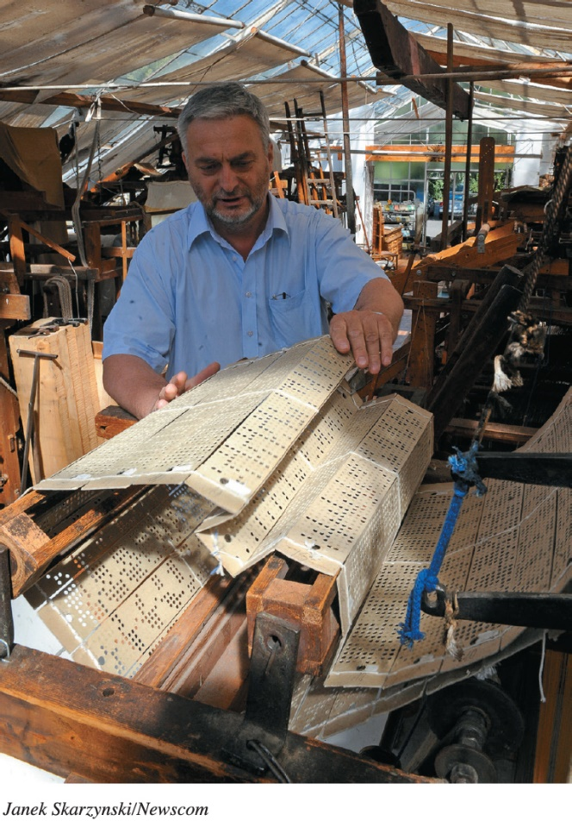
Making the Personal Computer Possible: Early Computers The Pascalene Calculator and the Jacquard Loom (2 of 2) (Objective A.10)
Created by Joseph Jacquard
Revolutionized fabric industry
Cards had punched holes; automated weaving complex patterns
Process adopted later; record and read data in computers using punch cards
Notes:
Nearly 200 years later, Joseph Jacquard revolutionized the fabric industry by creating a machine that automated the weaving of complex patterns. Although not a counting or calculating machine, the Jacquard loom was significant because it relied on stiff cards with punched holes to automate the process. Much later, this process would be adopted as a means to record and read data by using punch cards in computers.

Slide 20
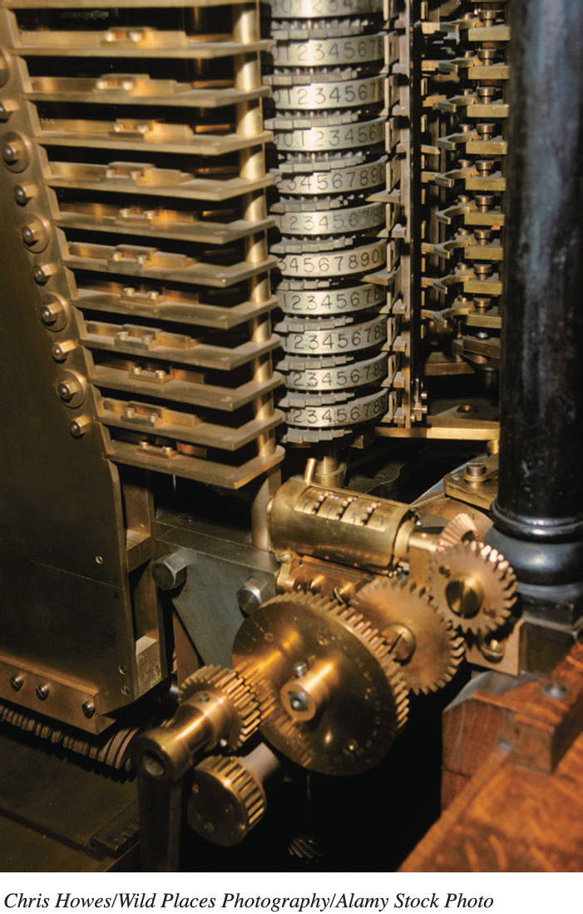
Making the Personal Computer Possible: Early Computers Babbage’s Engines and the Hollerith Tabulating Machine (1 of 2) (Objective A.11)
1834: Analytical Engine
Designed by Charles Babbage
First automatic calculator
Based on Difference Engine
Never developed
Drawings and descriptions similar to today’s computers
Notes:
Decades later, in 1834, Charles Babbage designed the first automatic calculator, called the Analytical Engine. The machine was actually based on another machine called the Difference Engine, which was a huge steam-powered mechanical calculator that Babbage designed to print astronomical tables. Babbage stopped working on the Difference Engine to build the Analytical Engine.
Although it was never developed, Babbage’s detailed drawings and descriptions of the Analytical Engine include components similar to those found in today’s computers, including the store (akin to RAM) and the mill (a central processing unit), as well as input and output devices. This invention gave Charles Babbage the title of “father of computing.”
Meanwhile, Ada Lovelace was fascinated with Babbage’s engines. She translated an Italian paper on Babbage’s machine, and at the request of Babbage, added her own extensive notes. Her efforts are thought to be the best description of Babbage’s engines.

Slide 21
Making the Personal Computer Possible: Early Computers Babbage’s Engines and the Hollerith Tabulating Machine (2 of 2) (Objective A.11)
1890: Hollerith Tabulating Machine
Created by Herman Hollerith
U.S. Census Bureau: Tabulate census data
Automatically read data from punch cards
1896: Hollerith started the Tabulating Machine Company
Later became International Business Machines (IBM)
Notes:
In 1890, Herman Hollerith, while working for the U.S. Census Bureau, was the first to take Jacquard’s punch-card concept and apply it to computing. Hollerith developed a machine called the Hollerith Tabulating Machine that used punch cards to tabulate census data. Up until that time, census data had been tabulated manually in a long, laborious process. Hollerith’s tabulating machine automatically read data that had been punched onto small punch cards, speeding up the tabulation process. Hollerith’s machine became so successful that he left the Census Bureau in 1896 to start the Tabulating Machine Company. His company later changed its name to International Business Machines, or IBM.

Slide 22
Making the Personal Computer Possible: Early Computers The Z1, the Atanasoff–Berry Computer, and the Harvard Mark I (1 of 3) (Objective A.12)
1936: Z1
Created by Konrad Zuse
Mechanical calculator
Included control unit and separate memory functions
Important breakthrough for future computer design
Notes:
German inventor Konrad Zuse is credited with a creating a mechanical calculator, called the Z1, in 1936. The Z1 is thought to be the first computer to include features that are integral to today’s systems, including a control unit and separate memory functions. These were important breakthroughs for future computer design.
In 1939, John Atanasoff and Clifford Berry built the first electrically powered digital computer, called the Atanasoff-Berry Computer (ABC). The computer was the first to use vacuum tubes to store data. Most important, it was the first computer to use the binary system. The design of the ABC would end up being central to that of future computer.

Slide 23
Making the Personal Computer Possible: Early Computers The Z1, the Atanasoff–Berry Computer, and the Harvard Mark I (2 of 3) (Objective A.12)
1939: Atanasoff–Berry Computer (ABC)
Created by John Atanasoff and Clifford Berry
First electrically powered digital computer
Used vacuum tubes to store data
First computer to use the binary system
Notes:
German inventor Konrad Zuse is credited with a creating a mechanical calculator, called the Z1, in 1936. The Z1 is thought to be the first computer to include features that are integral to today’s systems, including a control unit and separate memory functions. These were important breakthroughs for future computer design.
In 1939, John Atanasoff and Clifford Berry built the first electrically powered digital computer, called the Atanasoff-Berry Computer (ABC). The computer was the first to use vacuum tubes to store data. Most important, it was the first computer to use the binary system. The design of the ABC would end up being central to that of future computer.

Slide 24
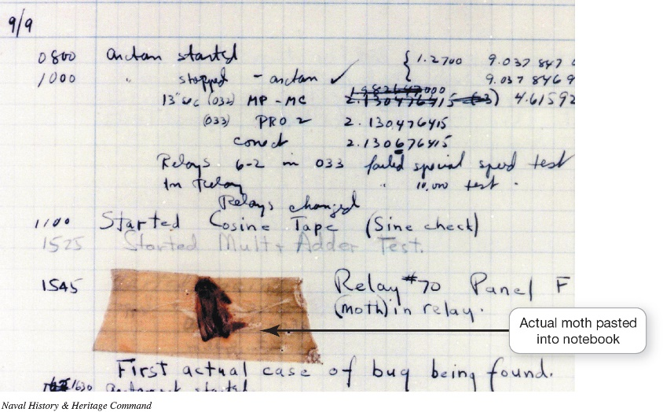
Making the Personal Computer Possible: Early Computers The Z1, the Atanasoff–Berry Computer, and the Harvard Mark I (3 of 3) (Objective A.12)
Mark series of computer were created by Howard Aiken and Grace Hopper
Used by U.S. Navy for ballistic and gunnery calculations
Hopper’s greatest contributions:
Inventing the compiler
Coining the term computer bug
Notes:
From the late 1930s to the early 1950s, Howard Aiken and Grace Hopper designed the Mark series of computers at Harvard University. The U.S. Navy used these computers for ballistic and gunnery calculations. Aiken, an electrical engineer and physicist, designed the computer, and Hopper did the programming. The Harvard Mark I, finished in 1944, could perform all four arithmetic operations (addition, subtraction, multiplication, and division).
Many believe Hopper’s greatest contribution to computing was the invention of the compiler, a program that translates English-language instructions into computer language. The team was also responsible for a common computer-related expression. Hopper was the first to “debug” a computer when she removed a moth that had flown into the Harvard Mark I and caused the computer to break down. After that, problems that caused a computer not to run were called “bugs.”

Slide 25
Making the Personal Computer Possible: Early Computers The Turing Machine, the ENIAC, and the UNIVAC (1 of 3) (Objective A.13)
Turing Machine
Abstract computer model: Could perform logical operations
Hypothetical model: Mathematically defined a mechanical procedure
Infinite tape that could be read, written to, and erased; precursor to today’s RAM
Notes:
In 1936, British mathematician Alan Turing created an abstract computer model that could perform logical operations. The Turing Machine was not a real machine, but rather a hypothetical model that mathematically defined a mechanical procedure (or algorithm).
Turing’s concept described a process by which the machine could read, write, or erase symbols written on squares of an infinite paper tape. This concept of an infinite tape that could be read, written to, and erased was the precursor to today’s RAM.

Slide 26
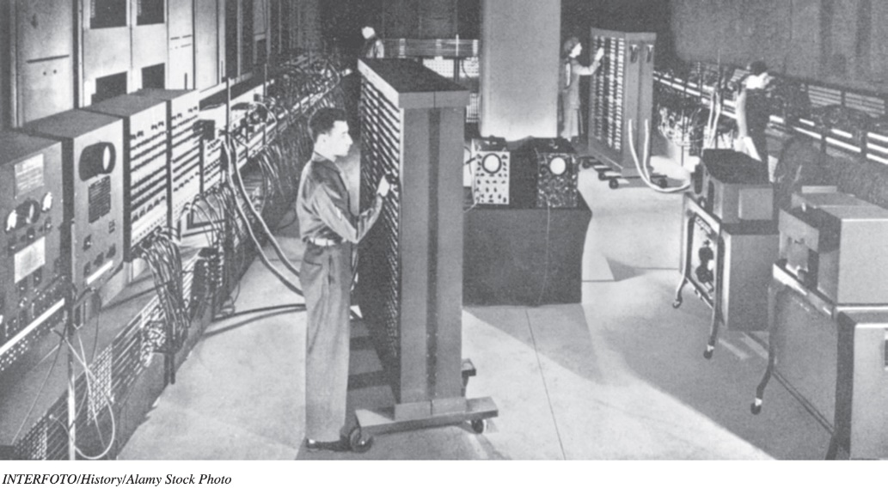
Making the Personal Computer Possible: Early Computers The Turing Machine, the ENIAC, and the UNIVAC (2 of 3) (Objective A.13)
Electronic Numerical Integrator and Computer (ENIAC)
First successful high-speed electronic digital computer
Big and clumsy
Used 18,000 vacuum tubes
Filled 1,800 square feet
Notes:
The Electronic Numerical Integrator and Computer (ENIAC) was another U.S. government-sponsored machine developed to calculate the settings used for weapons. Created by John W. Mauchly and J. Presper Eckert at the University of Pennsylvania, it was placed into operation in 1944. Although the ENIAC is generally thought of as the first successful high-speed electronic digital computer, it was big and clumsy. The ENIAC used nearly 18,000 vacuum tubes and filled approximately 1,800 square feet of floor space. Although inconvenient, the ENIAC served its purpose and remained in use until 1955.

Slide 27
Making the Personal Computer Possible: Early Computers The Turing Machine, the ENIAC, and the UNIVAC (3 of 3) (Objective A.13)
Universal Automatic Computer (UNIVAC)
First commercially successful digital computer
Operated on magnetic tape, not punch cards
Considered first-generation computer
Last to use vacuum tubes to store data
Notes:
The Universal Automatic Computer (UNIVAC) was the first commercially successful electronic digital computer. Completed in June 1951 the UNIVAC operated on magnetic tape. This set it apart from its competitors, which ran on punch cards.
The UNIVAC gained notoriety when, in a 1951, publicity stunt, it was used to predict the outcome of the Stevenson–Eisenhower presidential race. After analyzing only 5 percent of the popular vote, the UNIVAC correctly identified Dwight D. Eisenhower as the victor. After that, UNIVAC soon became a household word. The UNIVAC and computers like it were considered first-generation computers and were the last to use vacuum tubes to store data.

Slide 28
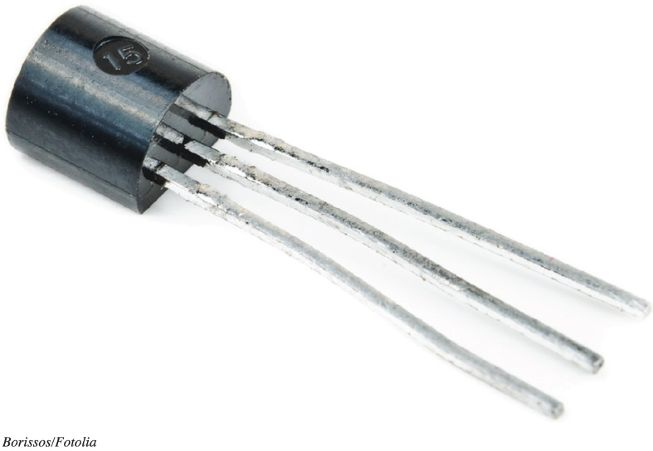
Making the Personal Computer Possible: Early Computers Transistors and Beyond (1 of 4) (Objective A.14)
Transistors (1945)
Invented at Bell Laboratories
Replaced vacuum tubes
Considered second generation computers
Notes:
In 1945, scientists at the Bell Laboratories invented the transistor as a means of storing data. The transistor replaced the bulky vacuum tubes of earlier computers and was smaller and more powerful.

Slide 29
Making the Personal Computer Possible: Early Computers Transistors and Beyond (2 of 4) (Objective A.14)
Integrated circuits (1958)
Invented by Jack Kilby of Texas Instruments
Small chip containing thousands of transistors
Enabled computers to become smaller and lighter
Considered third generation computers
Notes:
In 1958, Jack Kilby, while working at Texas Instruments, invented the world’s first integrated circuit, a small chip capable of containing thousands of transistors. This consolidation in design enabled computers to become smaller and lighter.

Slide 30
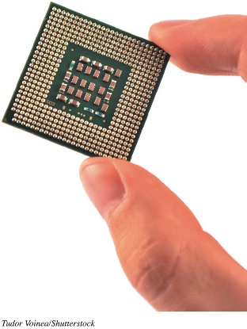
Making the Personal Computer Possible: Early Computers Transistors and Beyond (3 of 4) (Objective A.14)
Microprocessor was introduced by Intel Corporation in 1971
Small chip containing millions of transistors
Functions as the central processing unit (CPU)
Intel and Motorola became leading manufacturers
Considered fourth generation computers
Notes:
In 1971, the Intel Corporation introduced the microprocessor chip, a small chip containing millions of transistors. The microprocessor functions as the CPU.

Slide 31
Making the Personal Computer Possible: Early Computers Transistors and Beyond (4 of 4) (Objective A.14)
First-generation (1944)
Used vacuum tubes to store data
Second-generation (1945)
Used transistors to store data
Third-generation (1958)
Used integrated circuits
Fourth-generation (1971–today)
Uses microprocessor chip
Notes:
Computers have been classified into four generations. The first generation, including the ENIAC and UNIVAC, used vacuum tubes for memory. The second generation used transistors. Integrated circuits were the hallmark of third-generation computers. Fourth-generation computers use the microchip.

Slide 32
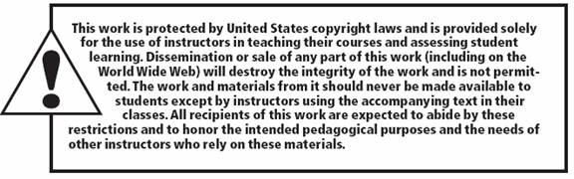
Copyright
All rights reserved. No part of this publication may be reproduced, stored in a retrieval system, or transmitted, in any form or by any means, electronic, mechanical, photocopying, recording, or otherwise, without the prior written permission of the publisher. Printed in the United States of America.

